Slide 1
From PSI to Ethernet

Slide 2
Our Goal
We want to read, store, package, and send the PSI data through Ethernet.
PSI data
Ethernet Packet
IO Interface
(FPGA)
1 bit per clock

Slide 3
To handle the Ethernet side, I chose to use the "AXI Ethernet Lite" IP, which allows data transmission up to 100 Mb/s.
To understand how it works, I thoroughly studied the IP's guide and the AXI protocol documentation.

Slide 4
AXI Ethernet Lite

Slide 5
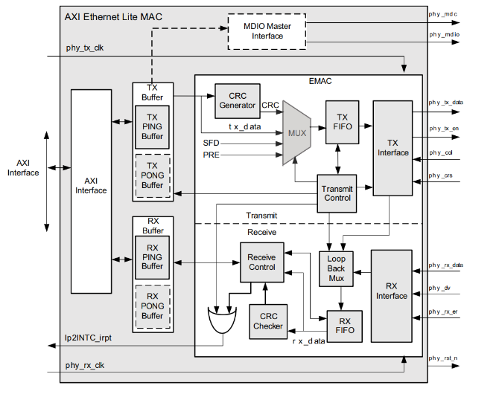
Block diagram:

Slide 6
2 Sides: AXI and PHY
The AXI side is the software (or user) side. It’s used as an interface with TX and RX blocks, that are both dual memory ports. They store, respectively, the transmission registers and the reception registers.
Additionally, we can choose the ping-pong configuration. It’s useful to have an extra slot of memory.

Slide 7
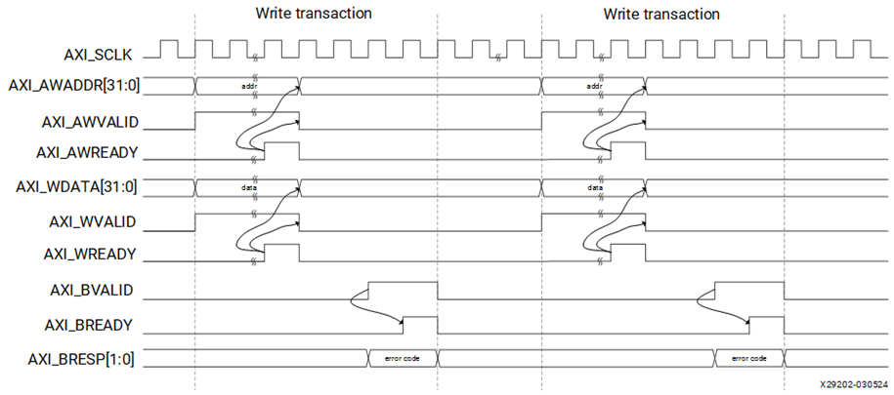
How to use the AXI interface?
-Write transaction (we must write into the TX block!)

Slide 8
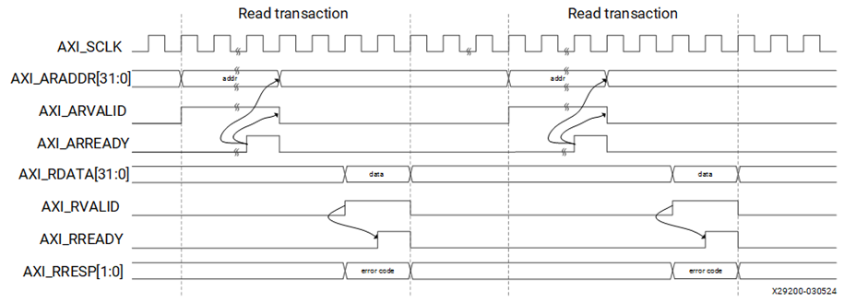
-Read Transaction (we can only read when a packet arrives into the RX!)
If there is a problem, the module sets an error code into s_axi_resp (in both r/w transactions)

Slide 9
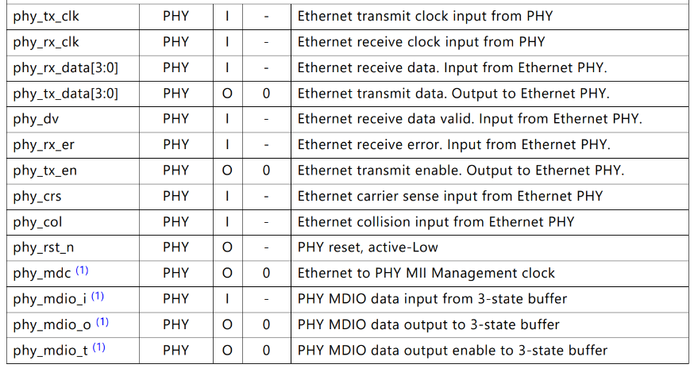
PHY interface:
The PHY acts as an intermediary between the AXI Ethernet Lite and the the RJ-45 connector. The Arty A7-35t should have it physically integrated, so it shouldn’t concern us.

Slide 10
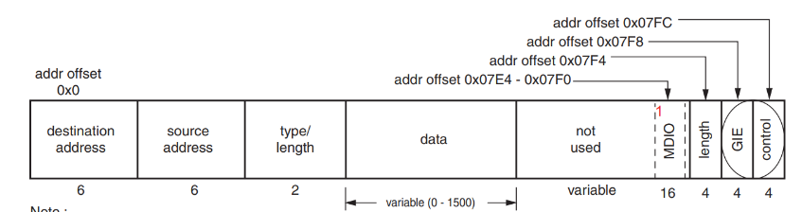
Steps to send an ethernet packet
We must write the packet configuration into the TX registers.

Slide 11
Starting at address 0x0, we should write through the AXI4 Lite protocol 32 bits per transaction into the TX memory.
Because of the word aligned addressing, the second four bytes are located at 0x4. The 32-bit interface requires that all four bytes be written at once.
We should write:
Destination address, source address (6 bytes), type/length (2 bytes), data (0-1500 bytes)

Slide 12
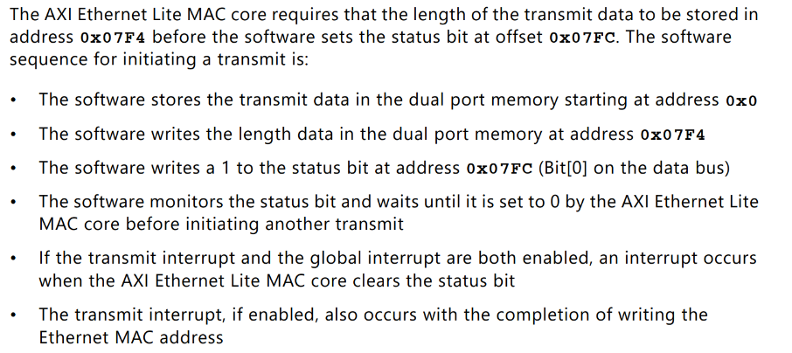

Slide 13
A little Recap:
We must write some Bytes into the transmission register before sending the packet (while we receive a psi bit per psi_clk)
When we “say” to the IP to send the packet, we cannot write into the register anymore until we receive the interrupt signal, unless we use the ping pong configuration: while (for example) ping is sending a packet, we can concurrently write into the pong buffer.
The s_axi_clock must be at 100MHz (that is exactly the max frequency of the psi_clk)
We do not want to lose any single psi bit.

Slide 14
My solution
First of all, when the IP is restarted, I automatically write into TX constant data: source MAC address, destination MAC address, type/length of the packet and other configuration bits of the TX register. In fact, those data will remain written into the register until the IP is restarted.

Slide 15
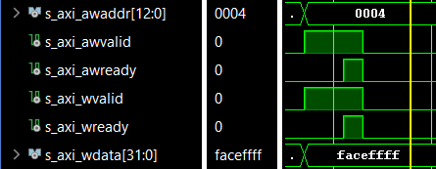
A writing transaction takes almost 70 ns, and during this time we write into the TX register 32 bits of data.
We receive PSI data one bit per clock, and we can write into the buffer only when we have 32 bits of data. We must use a 32-bit buffer in which we can save the psi data.

Slide 16
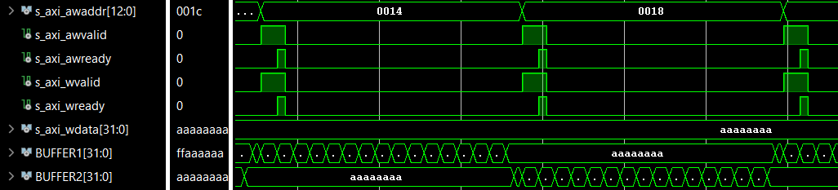
Psi clock: 100 MHz => 1 bit of data every 10 ns => 32 bits in 320 ns
If we save 32 bits into the register and then talk through the axi protocol to write it into the TX register, we could lose 7 bits of PSI data (70 ns). My solution: use 2 32-bit buffers! While one of them is used to write data into the TX register, the other is used to save the next psi data incoming.

Slide 17
Sending the Packet
As I said before, while the TX is transmitting a packet, it cannot be used to write another data until the transmission is over. That would mean: a lot of time while we cannot do anything; we do not want it. But if we use the ping-pong configuration, we can reduce this time a lot: while ping is used to transmit a packet, we use pong to write a packet into the TX memory, so when ping finishes the transmission, we start a new one with pong.

Slide 18
Problem
If we do not consider the first switch between ping and pong (when we start the transmission for the first time with ping, pong is already free to receive data), we encounter a problem: the writing phase is a bit more faster then the transmission one. In fact, for some time after we finish to write into Ping (or pong), we need to wait that pong (or ping) finishes the current transmission. (From my simulation, the time is 1,12 us vs 81,92 us of transmission)

Slide 19
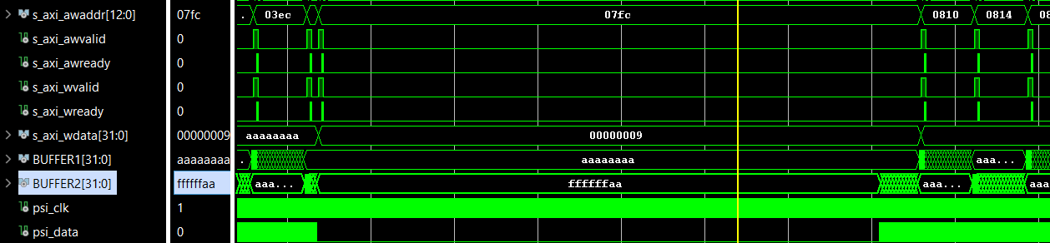
My solution
At this point i remembered that there is a way to stop the psi data stream. So, i simply thought to stop the data for that 1,12 us and to start it again when the ping (or pong) buffer finished the transmission and was ready to store new data.

Slide 20
…Another problem…
I forgot that the “psi stop port” was only ideal, used for simulating correctly while running the testbench. So, I tried to implement a FIFO that stores the psi data and, only when requested, drops the 32-bit word to the AXI interface, in order to store it into the TX registers.

Slide 21
IP: FIFO GENERATOR

Slide 22
Word size? FIFO length?
At the beginning, i was only sure about the word size: regardless of the word length used in the PSI protocol, the word size in the FIFO must be 32 bits. This is because the write buffer is 32-bit, and using this size increases overall throughput by optimizing the writing process to the TX registers.
As for the FIFO depth, I thought about a size large enough to prevent it from filling up, thus avoiding any risk of data loss… …as we will see, I optimized everything to have a very small FIFO.

Slide 23
IO Interface
(FPGA)
FIFO
PSI data
PSI word
AXI Eth Lite
Ethernet Packet
1 bit per clock
32-bit

Slide 24
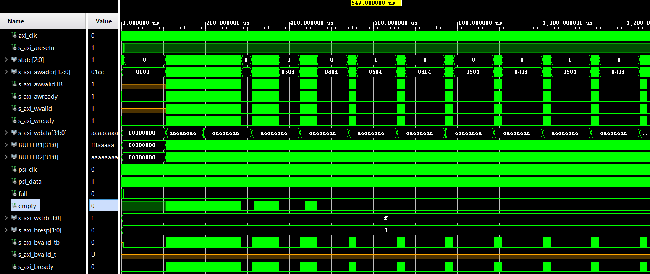
Reading Clock period > Writing Clock period
In this case ( PSI clock faster than AXI clock, that is impossible for us because the AXI clock is 100 MHz, the PSI clock is up to 100 MHz), we have this behaviour:

Slide 25
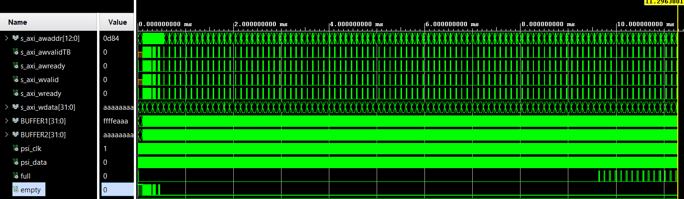
2 main things to notice:
Looking at “s_axi_awaddr”, we notice that the AXI Ethernet lite fills the TX register (ping or pong) much earlier then the instant when it is ready to send it. We like it: it means that we are in time for the next transmission.
In this case (that, reminding what I said before, it’s not our case) the FIFO stays in an empty state only for a certain time… That’s quite expectable: we’re writing faster than reading in this scenario.
In fact, the FIFO will eventually fill up!

Slide 26
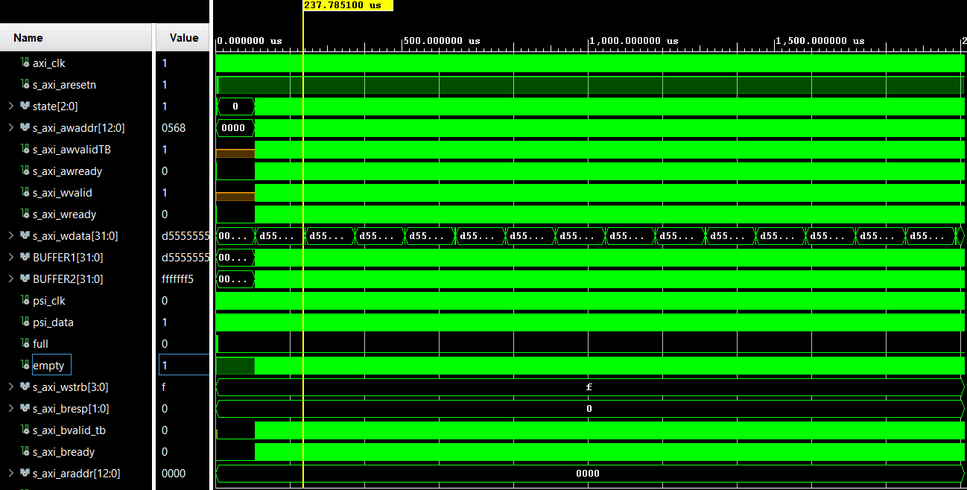
Reading Clock period < Writing Clock period
In this case ( PSI clock slower than AXI clock, that is our scenario), we have this behaviour:

Slide 27
Where is s_axi_awaddr?
We do not see it because that configuration (PSI clock at 83 MHz) is fully optimized: we have an ethernet throughput of 84,88 Mb/s . In fact, we are transmitting a packet of 1426 Bytes in 134,4 us.
(Looking quite similar… see the next slide). That’s because the axi is always ready to read a word from the fifo… and waits the PSI to write one into it. So, we notice an important thing! Now the PSI clock is what decides the average throughput! That is our bottleneck!

Slide 28
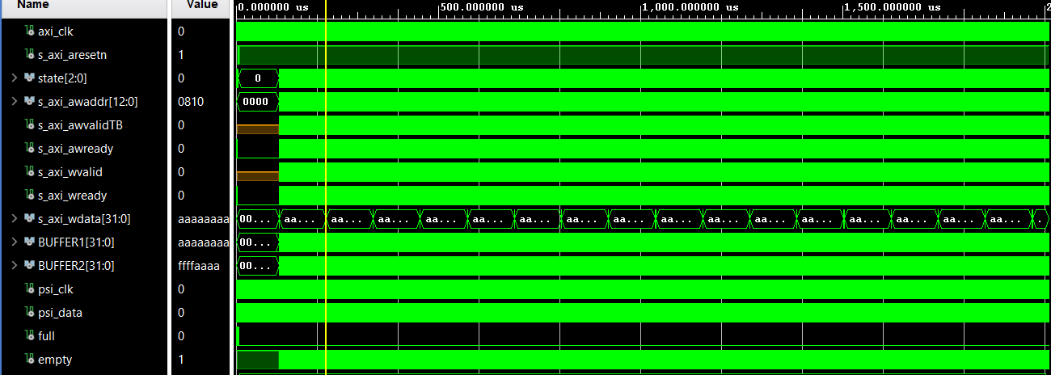
What if…
To confirm that the PSI frequency is our bottleneck, let’s try to change it!
With a PSI clock frequency of 98 Mhz (10.2 ns period):
It looks the same…
But looking at the time spent to send a single packet…
1426 Bytes in 116.48 us (less than before!) = 97.93 Mb/s ! (It is a little bit fewer because of the other data included in the packet)

Slide 29
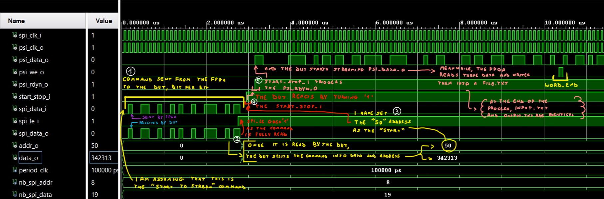
Let’s put all the flow together
Starting from the SPI…

Slide 30
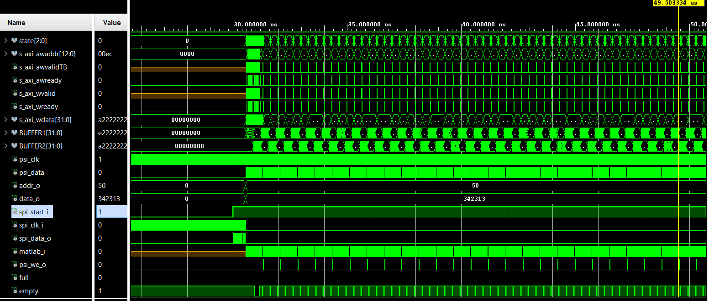
Connecting the PSI…

